Slide 1



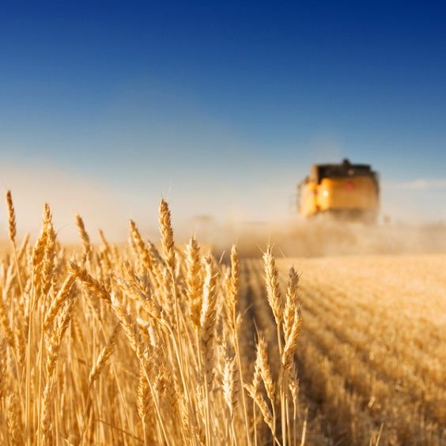
4 options for environmental-sound subsidies in rainfed & irrigated agriculture
Webinar Repurposing Subsidies in Agriculture and Water
20 November 2024, dr. Chris Seijger

Slide 2
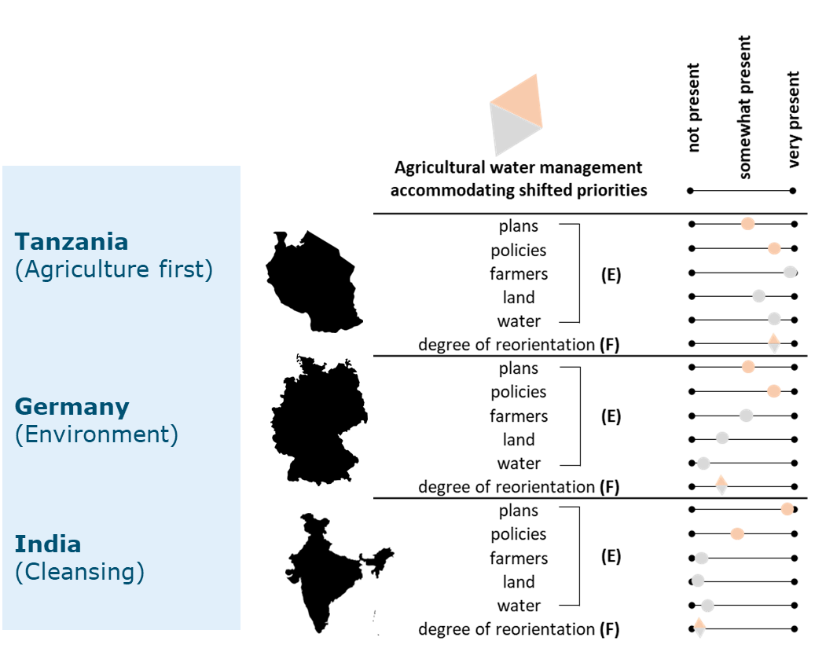
Reorientation: shift in broader societal priorities that drives reform of agricultural water management. (Seijger and Hellegers, 2023)
Subsidies, and subsidy reform, are one way to achieve changes in farming, water management and the environment.
Aim of research: offer recommendations for subsidy reform under the priority of ‘reducing environmental impact’
Fast and slow changes at different levels in a reorientation
(Seijger 2023)

Slide 3
Subsidies as course, imperfect means for a priority of ‘reducing environmental impact’
From literature review of +1074 publications:
  They don’t cover full costs for society.
  They make harmful activities cheaper.
  They target all and not the (most) needy with large farms benefitting more than smallholders as they have more land, larger production, use more inputs.
  They largely serve a priority of agricultural intensification while environmental conservation subsidies remain minor.

Slide 4
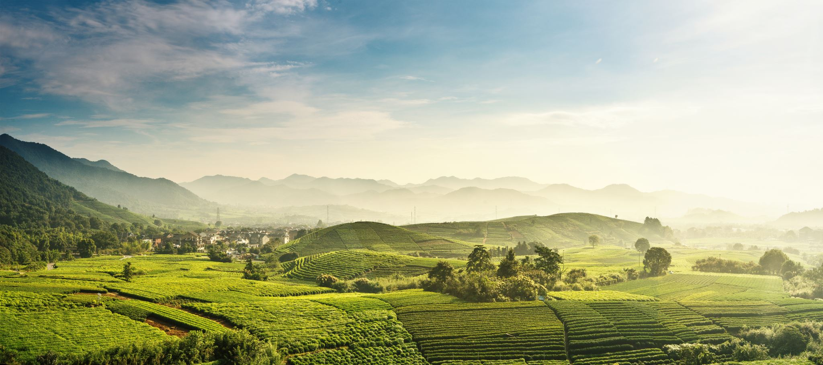
Reforming subsidies:
Coarseness
Priorities in society
Contribute to environmental sound changes
Notes:
Reforming subsidies:
Coarseness
Priorities in society
Contribution to environmental-sound changes

Slide 5
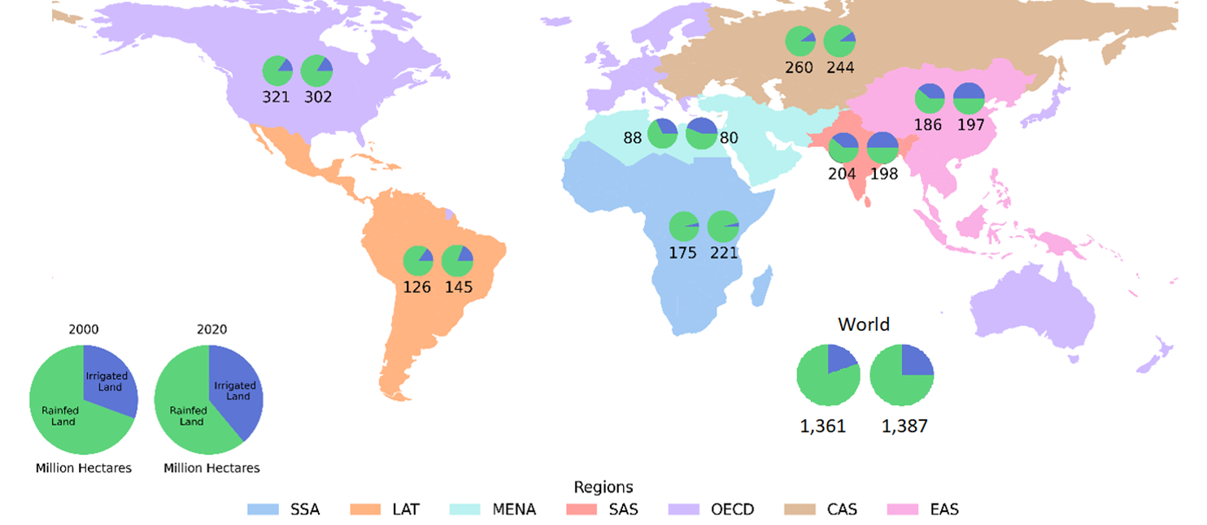
Income support for rainfed agriculture
Subsidies as income support caused by highly fluctuating growing conditions. A fixed subsidy per farm household, should be tied to a condition of farm area confinement to avoid expansion into nature.
Multiple ecosystem services (soil & water conservation, biodiversity) on (semi-)farm land due to extensive farming, production of crops livestock and fish, nature strips, cover crops, agroforestry.
~75% world’s arable land is rainfed but rapid expansion into nature areas.
(Seijger et al. in prep.)

Slide 6
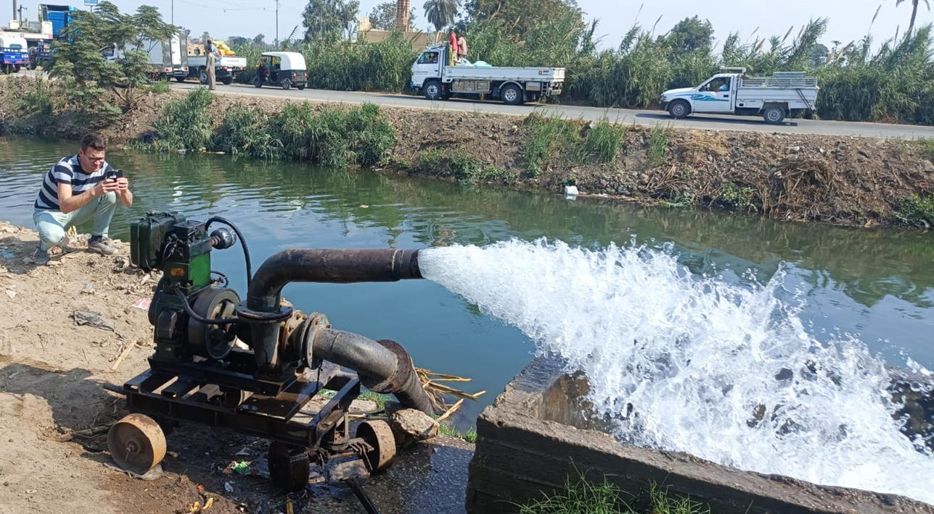
Phase out excessive inputs in irrigated agriculture
Phase out excessive use of subsidized fertilizer, pesticides and irrigation water.
Chemical pollutants move with percolating water into groundwater, streams and rivers. Excessive use of fertilizer beyond optimal rates is widespread, from China to the Netherlands, France and Germany, to subregions in South Asia and East Asia.
Unsustainable mining of groundwater in 40-50% off all irrigated areas. ~17% all nitrogen pollution in water due to subsidised fertilizer.
(Damania et al. 2023)

Slide 7
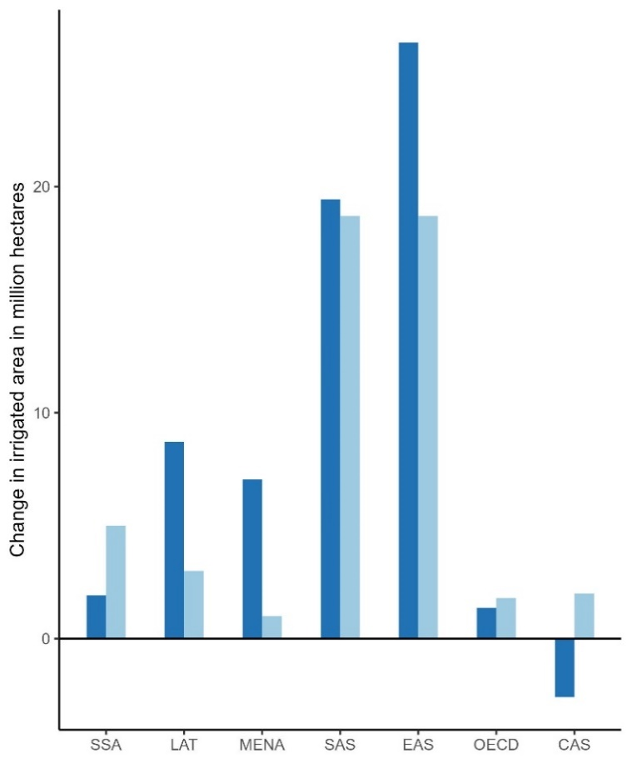
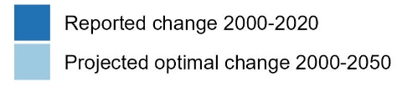
Restricted irrigation expansion
Subsidies for irrigation expansion in regions of water abundance and seasonal water shortage.
For instance regions in Europe, Latin America, sub-Saharan Africa, parts of central Asia. Not in ‘closed’ river basins or where groundwater resources are mined.
In Asia, Latin America and MENA, the reported growth in irrigated land in 2020 had already surpassed the projections for 2050 from Compr. Assessment ‘Water for Food Water for Life’ in 2007. (Seijger et al. in prep)
~50% irrigation expansion 2000-20215 took place in water-stressed areas. (Metha et al. 2024)

Slide 8
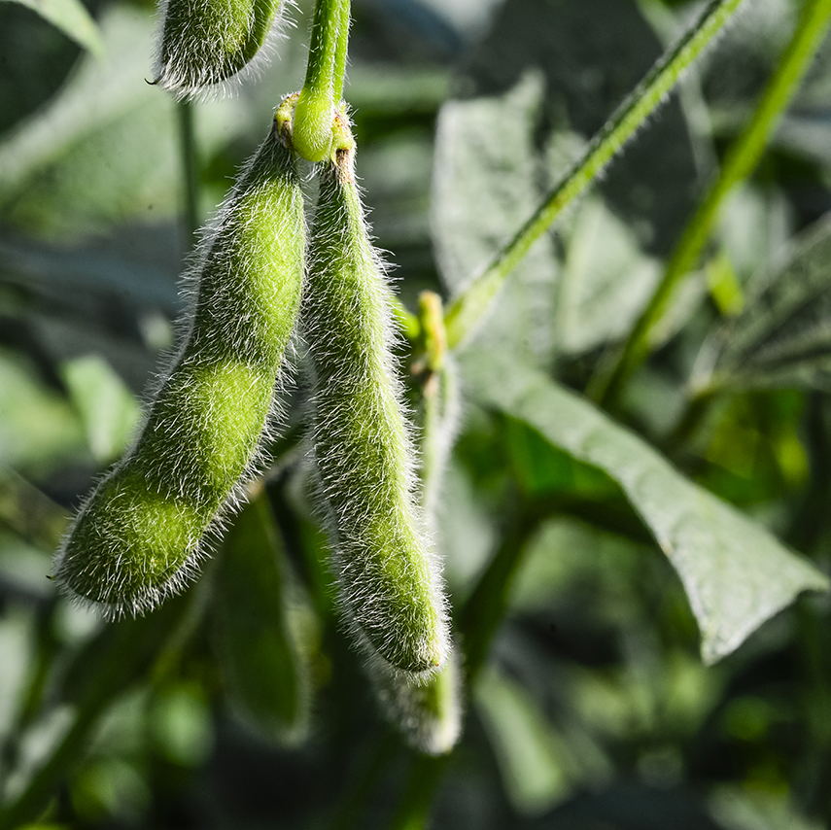


Subsidise production for plant-based diet
  Subsidies for human food crops in rainfed and irrigated agriculture, phase out subsidies for biofuel and animal feed crops.
  ~7% of soy is for human food, cereals 48%, livestock and dairy use nearly half of all arable land for ~18% world’s calory intake. Dietary change can reduce agricultural water depletion ~12%.
  (Poore et al. 2018; Ritchie 2021; Tuninetti et al. 2022)
2000-2020 land and water productivity gains did largely not materialise.
(Seijger et al. in prep.)

Slide 9

4 options for environmental-sound subsidies in agriculture and water
Income support for rainfed agriculture.
Phase out excessive inputs in irrigated agriculture.
Restricted irrigation expansion.
Remove subsidies biofuel and animal feed, subsidise crops for direct human consumption.

Slide 10
References
Damania et al. (2024) Detox Development. Repurposing Environmentally Harmful Subsidies. Washington, World Bank.
Metha et al. (2024) Half of twenty-first century global irrigation expansion has been in water-stressed regions. Nature Water.
Poore et al. (2018) Reducing food’s environmental impacts through producers and consumers. Science.
Ritchie et al. (2021) If the world adopted a plant-based diet, we would reduce global agricultural land use from 4 to 1 billion hectares.
Seijger et al. (under review) More food, less water and nature: why productivity gains did not materialize. Agricultural water management.
Seijger (2023) How shifts in societal priorities link to reform in agricultural water management: analytical framework and evidence from Germany, India and Tanzania. Science of Total Environment.
Seijger and Hellegers (2023) How do societies reform their agricultural water management towards new priorities? Agricultural Water Management.
Tuninetti et al. (2023) Compliance with EAT–Lancet dietary guidelines would reduce global water footprint but increase it for 40% of the world population. Nature Food.

