Slide 1

Tidal river management as a strategic innovation for the SW of Bangladesh?
Colloquium UN World Water Day 2018
University of Hohenheim
Dr. Chris Seijger, c.seijger@un-ihe.org

Slide 2
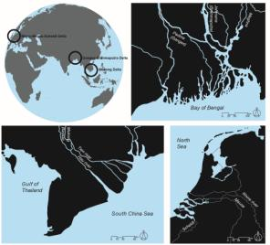
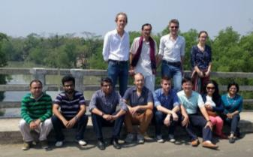







Strategic Delta Planning project, financed by NWO. More info: strategic-delta-planning.unesco-ihe.org

Slide 3

Silt and water in Bangladesh
Theoretical intermezzo
TRM, putting a strategic innovation into practice?

Slide 4
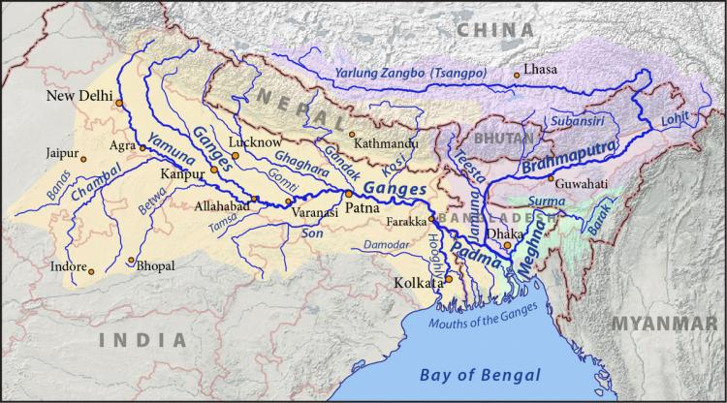
The Ganges Brahmaputra Meghna river basin
Notes:
https://www.google.de/search?client=firefox-b-ab&dcr=0&biw=1280&bih=915&tbm=isch&sa=1&ei=WwBmWve8HdL5wALA1rPwDw&q=ganges+brahmaputra+basin+map&oq=ganges+brahma&gs_l=psy-ab.3.1.0i19k1l8j0i8i30i19k1.97607.99326.0.100837.13.13.0.0.0.0.155.1273.9j4.13.0....0...1c.1.64.psy-ab..0.13.1270...0j0i67k1j0i30i19k1.0.AsIw2dzoxNQ#imgrc=ghoHUlJehIRSkM:

Slide 5
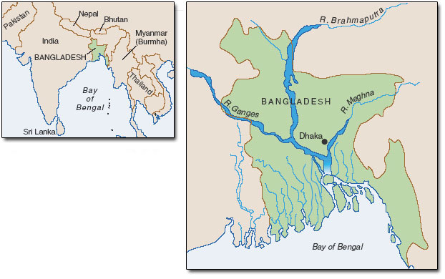
Bangladesh, delta country where 3 major rivers meet
Political system | Two major party democracy
Population | 157 million
Discharge per year | 1070 x10^9 m3/yr
Notes:
Relative young democracy. Liberation war east Pakistan in 1971
Population: most densely populated country
Discharge: river rhine 70 km3, 15 times
http://underthreatunderwater.blogspot.de/2012/12/sink-or-swim-ganges-delta.html

Slide 6
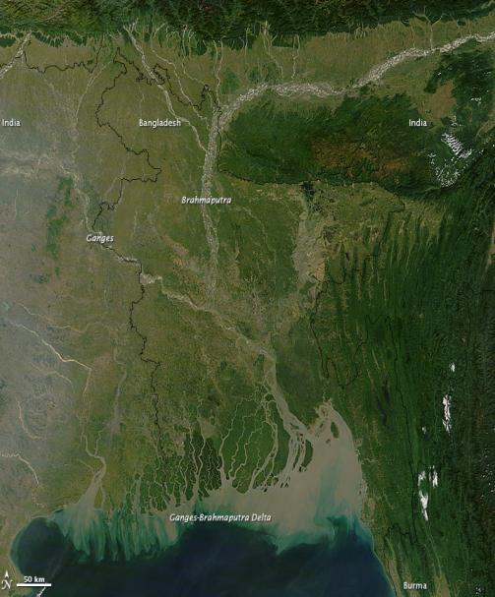
Notes:
Not only impressive in terms of water flow, but also sediment
Show air land viewer deltares http://aqua-monitor.appspot.com/

Slide 7
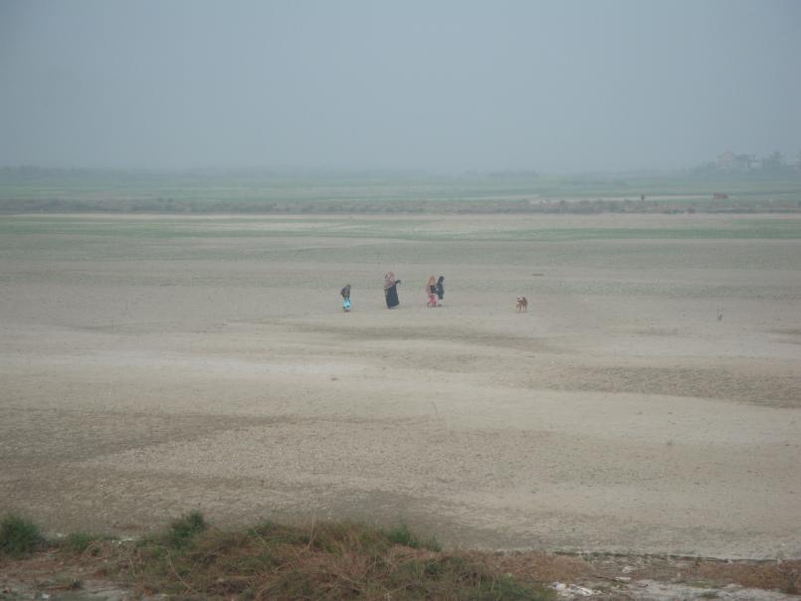
Silt deposited in Padma river, forming islands ‚chars‘. Housing and agriculture on charland, usually landless people.
Notes:
Insert pictures of charland in padma river

Slide 8
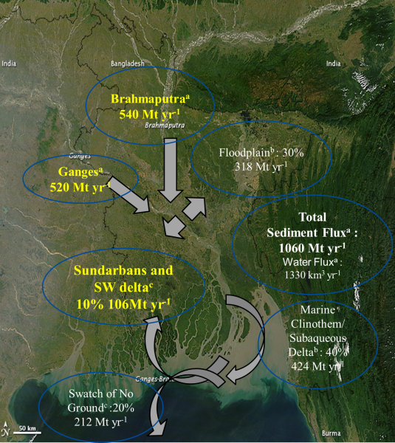
Slide by Prof. Dilip Datta.
Derived from:
(a) Milliman et al., 1995, (b) Goodbred et al., 1999, (c) Rogers et al., 2013.

Slide 9
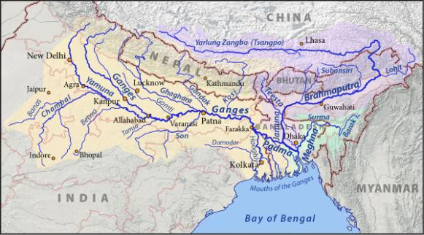
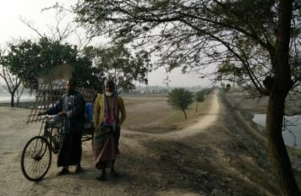
Major interventions in water-sediment system
  Farakka Barrage created by India in 1975.
  2. Coastal polders and their embankments in 60s and 70s.
Notes:
Decreasing inflow (sediment and water) into Bangladesh
Polders boosted food production but constrain sediment overflow in flood plains.

Slide 10
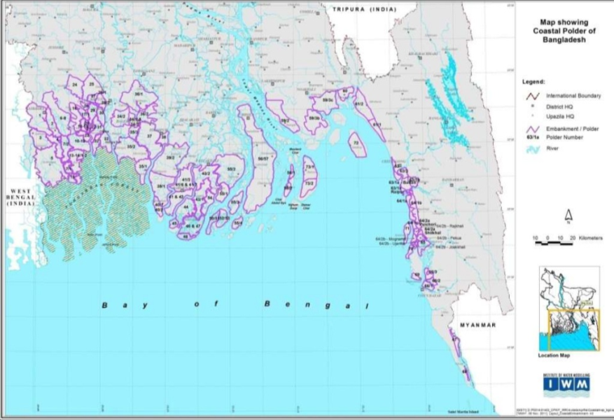
Polder 30
Polder 23
Notes:
139 polders in coastal zone
2.8 million ha land in coastal zone, 1.2 million ha turned into polder

Slide 11
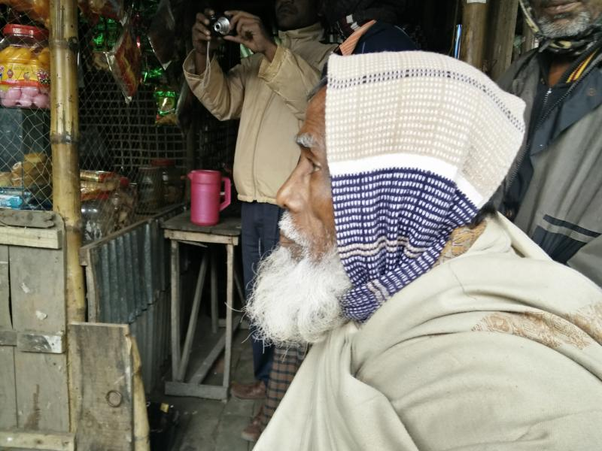
Within polder 30: life was hard before the polders were constructed. Many floods, not enough food. They could not throw away rotten rice. Polders brought prosperity (infrastructure, houses, schools). Rice yields were higher before polders were constructed, flooding would bring fresh sediment.

Slide 12
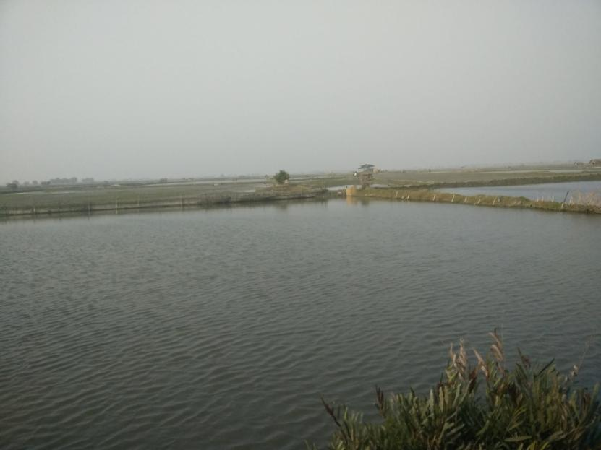
Within polder 23: shrimp farming very profitable. Demands major financial investments. Brackish shrimp farming dominate small dry-land farmers through muscle man. Rice-shrimp or rice farming not possible in polder.

Slide 13

The natural system of water and sediment flows is strongly disturbed by two major interventions:
  Farakka Barrage created by India in 1975
  Coastal polders and their embankments in 60s and 70s.
  Consequences: strongly reduced river dynamics‚ water logging in the southwest, impacting livelihoods of 1-10 million people.
Limits of engineering strategies are increasingly experienced in the South-West

Slide 14
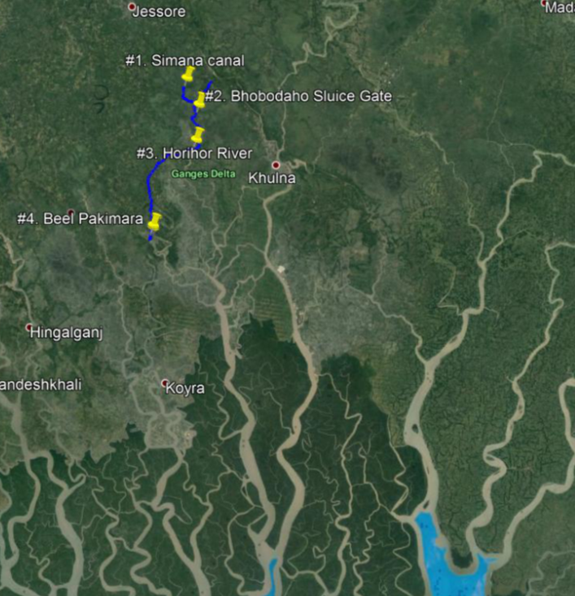
Impacted livelihoods
#1: we need TRM
#2: dredging is useless
#3: the dying Horihor river
#4: TRM project
Polder 23 and 30
Scale: ~40 km from point 1 to 4
Notes:
Polder 30

Slide 15
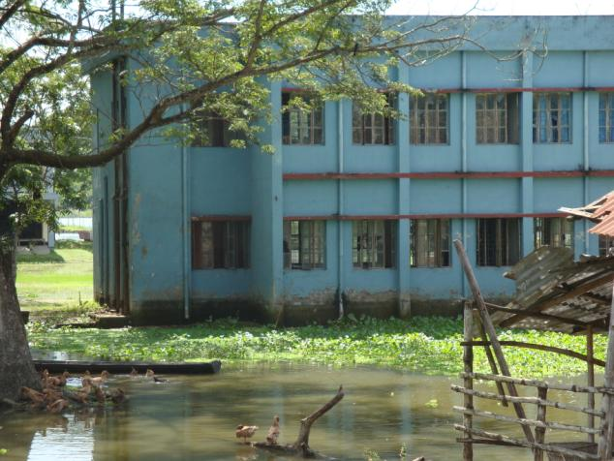
#1 Water logging: Farmers loose 50% rice crops, primary school closed for 2 months. Advocacy to remove sluice gate which is blocking river flow and sediment.
Notes:
Monsoon rice can no longer be grown, still water on the fields. Gradually loose summer rice crop as well.

Slide 16
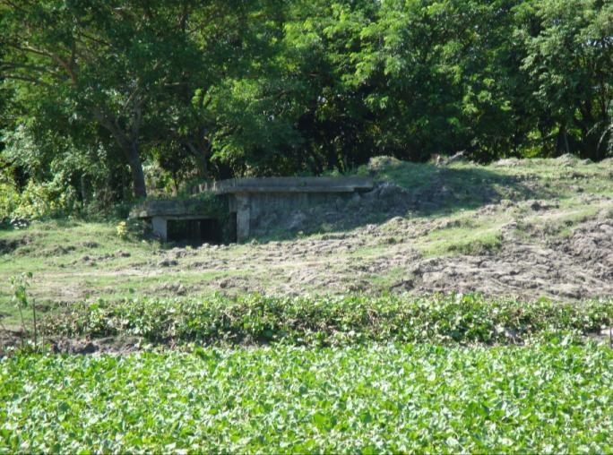
#2 Dredging at Bhobodaho sluice gate.
House of gate operator covered in mud.
Locals about the dredging “half the money disappears, and due to siltation dredging is undone within one month”.
Notes:
If you scoop a glass of water, twothird filled with silt

Slide 17
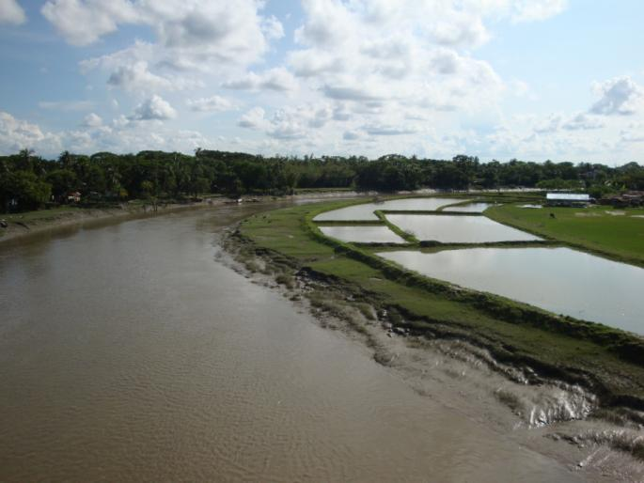
#3 Siltation of Horihor River. (New) land on silted river bank is grabbed by local elites.

Slide 18
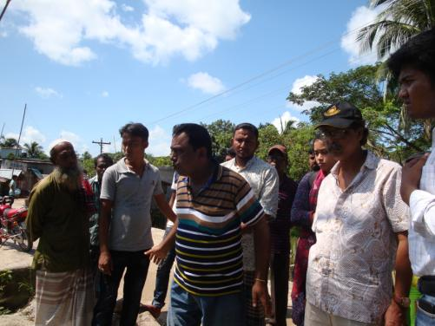
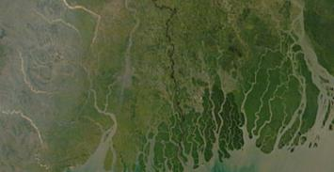
Tidal river management is advocated by some as a more natural strategy to restore river dynamics and overcome water logging in low-lying areas, so-called beels.
Several TRM projects have been
undertaken along the south-west
tidal rivers, formal and informal.
Overview: Mutahara, 2018.
Notes:
Insert sheet from CEIP on coastal polder map presentation (in folder other docs and reports)

Slide 19
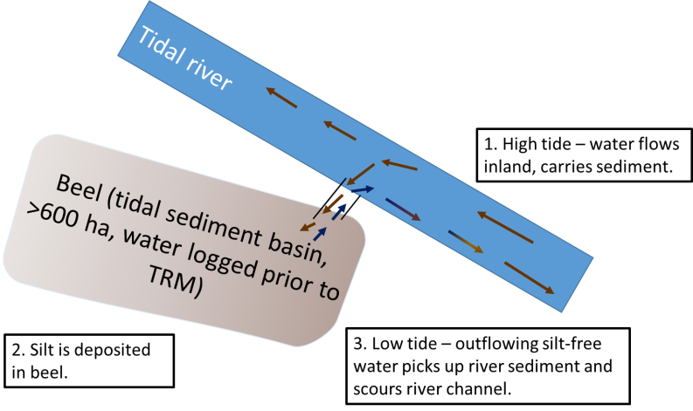
Conceptual figure TRM
Elevation gain 1-3 meters over ~5 years

Slide 20
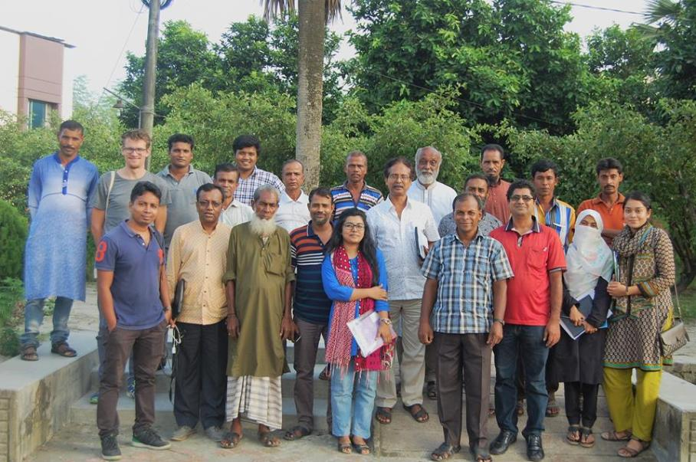
Elevation gain 1-3 meters over ~5 years but….
…people have to abandon their land, making it difficult to implement
Notes:
Insert pictures from TRM Pakimara

Slide 21
In the region there is strong disagreement on the best way to manage the water and silt
Tidal river management
-A natural, local solution to save rivers and lands
-Associated with conflicts
-Implementation difficultlies
-participation
-transparency
-compensation land owners
-decentralised structure
-No permanent solution, many failures in experiences so far
Hard infrastructure (dredging, embankments, sluice gates)
-Quick results for politicians
-Easy to implement
-Enables centralised management
-Opportunity for corruption
-Criticised as it increases siltation, water logging, no permanent solution
What do you think, which strategy is most widely supported??

Slide 22
Who is supporting TRM (left), who is favouring dredging, sluice gates, polder embankments (right)_
Water Development Board
Shrimp farmers
Local communities dry-land farmers
Local government
Prime minister
Planning Commission
NGOs
Civil engineers
Researchers from SW delta
Donors

Slide 23

But why still go for TRM?
„a basic necessity to survive in this region that considers the natural process to replace huge amounts of sediment into beel areas“
„ so that I know my children have a better life“
„the only way to save these rivers, raise our lands“
„with TRM we can go from 1 crop of rice to 3-4 crops per year for 2-5 generations“

Slide 24
Silt and water in Bangladesh
Theoretical intermezzo
TRM, putting a strategic innovation into practice?

Slide 25
A strategic innovation is the fundamental reconceptualization of the business model and the reshaping of existing markets (by breaking rules and changing nature of competition) to achieve dramatic value improvements for customers and high growth for companies (Schlegelmilch et al., 2003)

Slide 26
Study TRM as strategic innovation:
Fundamental reconceptualization of business model
Leaps in value
Breaking rules and reshaping markets
Sustainability – fit in long term perspective

Slide 27
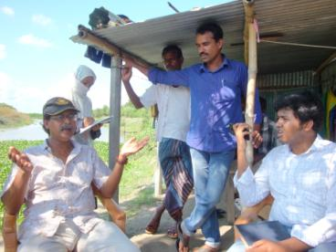
Data collection
Primary data:
  17 interviews at national (10) and local level (7)
  1 focus group discussion with 21 villagers
Secondary data:
  7 national plans and policies SW delta
  10 consultancy reports
  6 newspapers English language
  3 field trips Khulna
Notes:
Plans: EIA KJDRP, CEIP, BDP, 5 Year Plan, WB, ADB, Water Act
Reports:

Slide 28
Silt and water in Bangladesh
Theoretical intermezzo
TRM, putting a strategic innovation into practice?

Slide 29
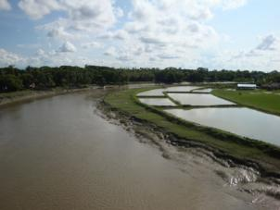
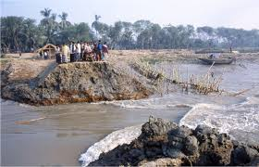

Fundamental reconceptualization
Cope with water logging and drainage through:
  Reconnect low lying areas with rivers by temporal restoration of water-sediment flows
  Local people‘s idea versus engineer‘s knowledge, nature-driven vs engineering approach
Notes:
Large land owners are favoured

Slide 30
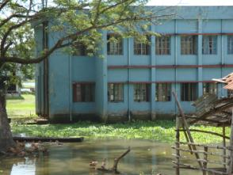
Leap in value
… but not automatically supported at local level or influential decision-makers
TRM can generate leap in value..
  Overcome water logging, from 1 crop to 3 crops
  Land elevation linked with better livelihood for future generations
  Leaps can be achieved as current strategies contributed to harsh, water logged living environment

Slide 31

Break rules and reshape markets
  -Illegal breaching of embankments
  -Step up against police, army, national Government
Rules and markets to be reshaped
  TRM design correspond with local people‘s knowledge
  Compensation should become easier and fairer
  Market of water projects not reshaped

Slide 32
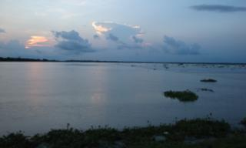


Sustainability – fit in long term perspective
- Future generations
- Restore sediment-water flows
- Enliven „deadly rivers“
- TRM plans are made, incl. rotation
A focus needed on multiple benefits for people and environment
  Strategic thinking on silt as valuable resource largely absent
  Little attention to social-ecological aspects of TRM (riverine flora and fauna, link with aquaculture)
  Conflicts between landowners (large vs small) and shrimp vs dryland farmers have to be resolved

Slide 33
Silt and water in Bangladesh
Theoretical intermezzo
TRM, putting a strategic innovation into practice?

Slide 34
Conclusions
TRM is a strategic innovation for management of land and water resources in SW Bangladesh.
Fundamental reconceptualization of managing water-silt-land for SW is there.... But requires further evolvement (aquaculture, ecological benefits, shrimp farming, strategic considerations)
TRM as strategic innovation offers a compelling view how the SW delta could be developed, that has to date hardly influenced master plans and the market of water projects.

Slide 35
Propositions on nature-based solutions
I. A black-white or green-gray distinction is not fruitful
Nature-based solutions have to be embeddded in heavily engineered landscapes. Compelling visions how nature-driven and engineering approaches mutually reinforce each other are needed.
II. Recognize limits of „own“ nature-based strategies
Benefits of nature-based solutions may be clear, but not widely supported (rules+markets). Evolvement from initial concepts are needed, social + technological, to advance implementation.
III. A corporate perspective is refreshing to dust off ecological wishful thinking on nature-based solutions

Slide 36
Further reading
Goodbred Jr, S. L., & Kuehl, S. A. (1999). Holocene and modern sediment budgets for the Ganges-Brahmaputra river system: Evidence for highstand dispersal to flood-plain, shelf, and deep-sea depocenters. Geology, 27(6), 559-562.
Milligan, B., & Holmes, R. (2017). Sediment is critical infrastructure for the future of California's Bay-Delta. Shore & Beach, 85(2), 1-13.
Mutuhara, M. (2018). Turning the tide? The role of participation and learning in strengthening tidal river management in the Bangladesh delta. (PhD thesis), Wageningen University, Wageningen.
Rogers, K. G., Goodbred, S. L., & Mondal, D. R. (2013). Monsoon sedimentation on the 'abandoned' tide-influenced Ganges-Brahmaputra delta plain. Estuarine, Coastal and Shelf Science, 131, 297-309.
Schlegelmilch, B. B., Diamantopoulos, A., & Kreuz, P. (2003). Strategic innovation: the construct, its drivers and its strategic outcomes. Journal of Strategic Marketing, 11(2), 117-132.

Slide 37
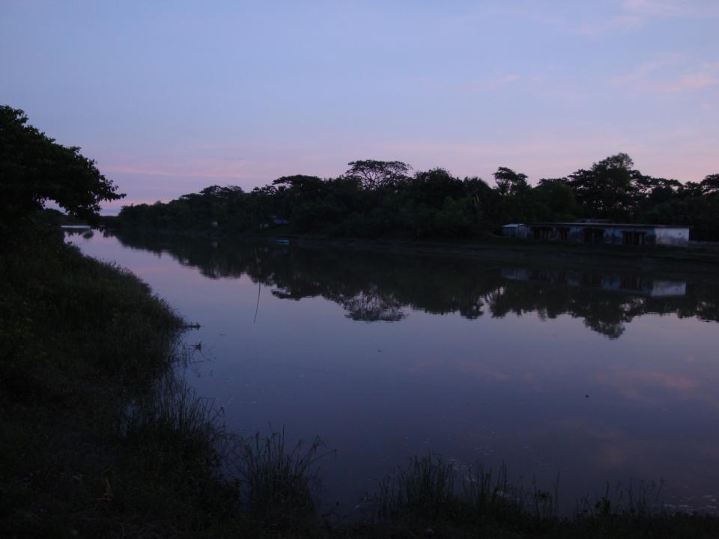
A warm thanks to prof. Datta and research assistants at Khulna University and CEGIS, interviewees, colleagues of the Strategic Delta Planning project, funder NWO, Anton & Petra Ehrman-Stiftung Research Training Group.

